Slide 1
Measuring Packet Processing Overheads In the Linux Kernel
Student - Razi Murshed
ID - 260516333
Course – ECSE 498
Supervisor – Professor MuthuCumaru Maheswaran

Slide 2
Motivation
Increased popularity of Cloud Computing leading to increased remote procedure calls.
Access to a remote machine faces high latency in various aspects.
Protocol processing overheads of source and destination machines a key cause of latency.
Measuring and studying the processing overheads may lead to finding improvements in current implementation and reduction of latency.
Operating systems (OS) in various computing platforms responsible for packet processing and responsible for most of the latency.

Slide 3
Remote Procedure Calls in Linux
Server
Client
Client Functions
Server Functions
1
10
5
6
Client Functions
Client Functions
2
9
3
4
7
Kernel Space
Sockets
Sockets
8

Slide 4
Project Objectives
Design experiments to measure protocol processing overheads for data packets
Measure for different types of protocols - TCP, UDP etc.
Measure for different types of networking : wired, wireless, local etc.
Carry out measurements in various environments : bare metal machine, cloud, virtualized environment etc.
Analyze collected data to find possible improvements for reducing the current latency in accessing remote computers.

Slide 5
Main Challenges
Finding suitable OS and software to be able to track packet activity inside the OS.
Packet loss occurs even in controlled transmission and reception.
Finding entry and exit points of packet from the Operating System.
Obtaining the detailed path of packet in OS for different protocols.
Accommodating experiments for garbage packets, unexpected transmission and reception.
Controlling transmission and reception when carrying out measurements.

Slide 6
Main Constraints
Not all types of OS available for close scrutiny.
Hardware constraints such as available machines and their specifications for experiments.
Software constraints arising from choice of OS for experiment design.
Certain number and types of networks available to test currently.
Adherence to certain standards and protocols in order to simulate real scenarios when generating and receiving traffic.

Slide 7
Applications
Data over WiFi
Cloud Computing Practices
Packet Processing Architectures
Encryption/Decryption Techniques
Tethering mobile devices to Personal Computers over local network.
Fog Computing

Slide 8
Progress This Semester
Operating System and physical machine configured and set up for project.
Linux kernel studied extensively to gain a better understanding of how packets are processed within.
SystemTap scripting learned in order to monitor and access kernel.
End-to-end processing times measured through SystemTap Experiments for Transmission Control Protocol (TCP/IP) and User Datagram Protocol (UDP).
Layer by layer processing times in kernel measured.
Several sets of data from bare metal machines on wired networks collected and analyzed.

Slide 9
Design Decisions – Linux Ubuntu 14.04 LTS
Open source OS with all of source code available.
Linux used in most server networks today.
Driver code available for networking hardware.
Administrator has full control of network increasing management and reliability.
Ubuntu 14.04 LTS tested and proven, user friendly and most widely used distribution.
Available at no cost.

Slide 10
Design Decisions – SystemTap
Native to Linux, provides easy access to the kernel.
Creates a debuggable version of the kernel that mimics original to protect the integrity of the OS.
No need to recompile kernel source code every time a change is made.
C like syntax, user friendly, supports embedded C and command line interface driven.
Can monitor kernel functions, variables and data structures in real time to give accurate and valuable data.

Slide 11
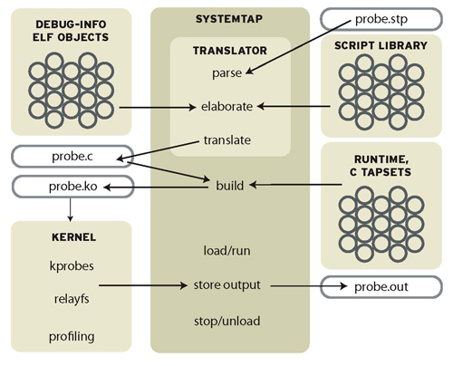
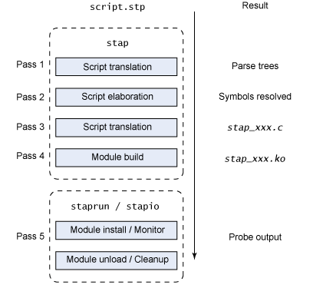
SystemTap Data Flow
SystemTap Process
Image taken from http://www.ibm.com/developerworks/library/l-systemtap/

Slide 12
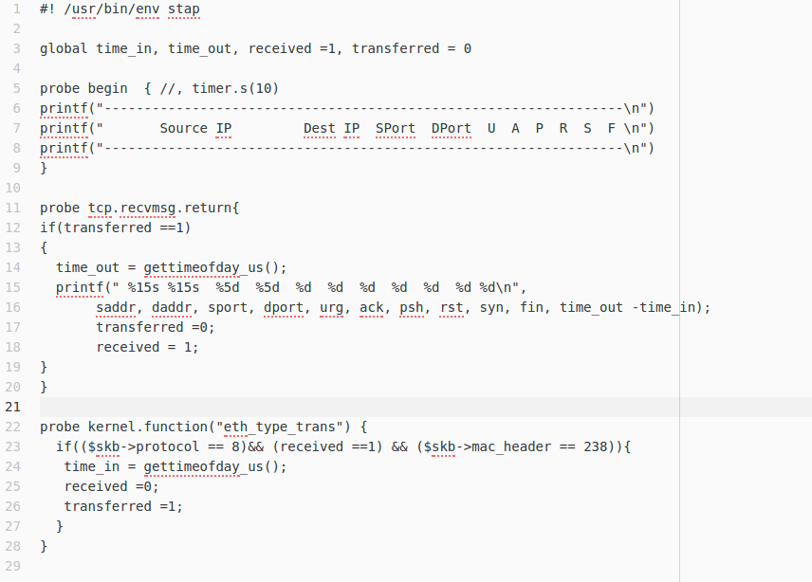
Sample SystemTap Script

Slide 13
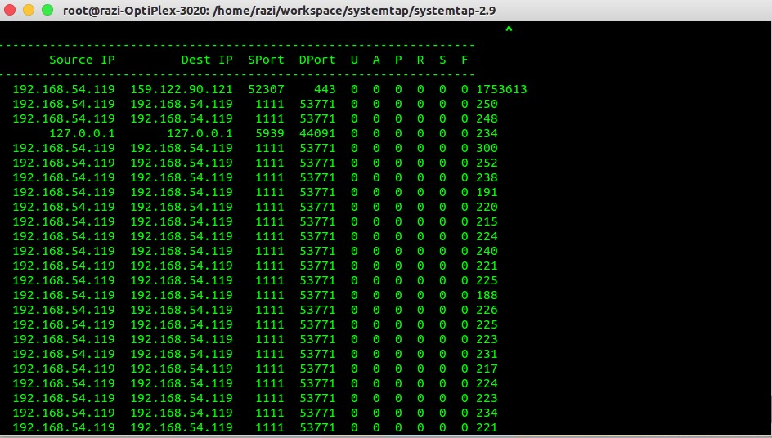
Output From Sample Script

Slide 14
Design Decisions – Protocols
TCP/IP and UDP chosen
TCP/IP most ubiquitous network protocol today.
UDP gaining increasing popularity due to low processing overhead.
Both types of connections can be established in Linux using the netcat tool which is built in.
A controlled environment for experiments can be designed with netcat.
Stream Control Transmission Protocol (SCTP) may be considered if time permits due to its improved resilience and reliability.

Slide 15
Experiment – UDP Packets End to End
Entry point of kernel identified at the interface between the physical layer and Network Layer when the ethernet card (for wired connection) interrupts the OS.
Exit point is udp_recvmsg() function in the transport layer.
SystemTap script written to probe two points and timestamp them. The difference in timestamps is the processing time.
Aforementioned script was run in parallel with the netcat tool (generates UDP traffic) in conjunction with a batch script to repeat the experiment multiple times.

Slide 16
Experiment – UDP Packets Network Layer
Entry point of kernel is interrupt from Ethernet card
Exit point is udp_recv() function in the network layer.
SystemTap script written to probe two points and timestamp them. The difference in timestamps is the processing time.
Aforementioned script was run in parallel with the netcat tool (generates UDP traffic) in conjunction with a batch script to repeat the experiment multiple times.

Slide 17
Experiment – UDP Packets Transport Layer
Entry point of transport layer is udp_rcv() function from network layer
Exit point is udp_recvmsg() function in the transport layer.
SystemTap script written to probe two points and timestamp them. The difference in timestamps is the processing time.
Aforementioned script was run in parallel with the netcat tool (generates UDP traffic) in conjunction with a batch script to repeat the experiment multiple times.

Slide 18
Analysis - UDP Packets End to End
Statistics
Raw Average 183.813
Raw Median 161
Raw Mode 139
Standard Deviation 155.754
Average Without Outlier 167.253
Samples 10000
Connection Wired

Slide 19

Analysis - UDP Packets Network Layer
Analysis - UDP Packets Transport Layer
Statistics
Raw Average 27.964
Raw Median 27
Raw Mode 29
Standard Deviation 10.15
Samples 10000
Connection Wired
Statistics
Raw Average 120.627
Raw Median 115
Raw Mode 115
Standard Deviation 30.082
Samples 10000
Connection Wired

Slide 20
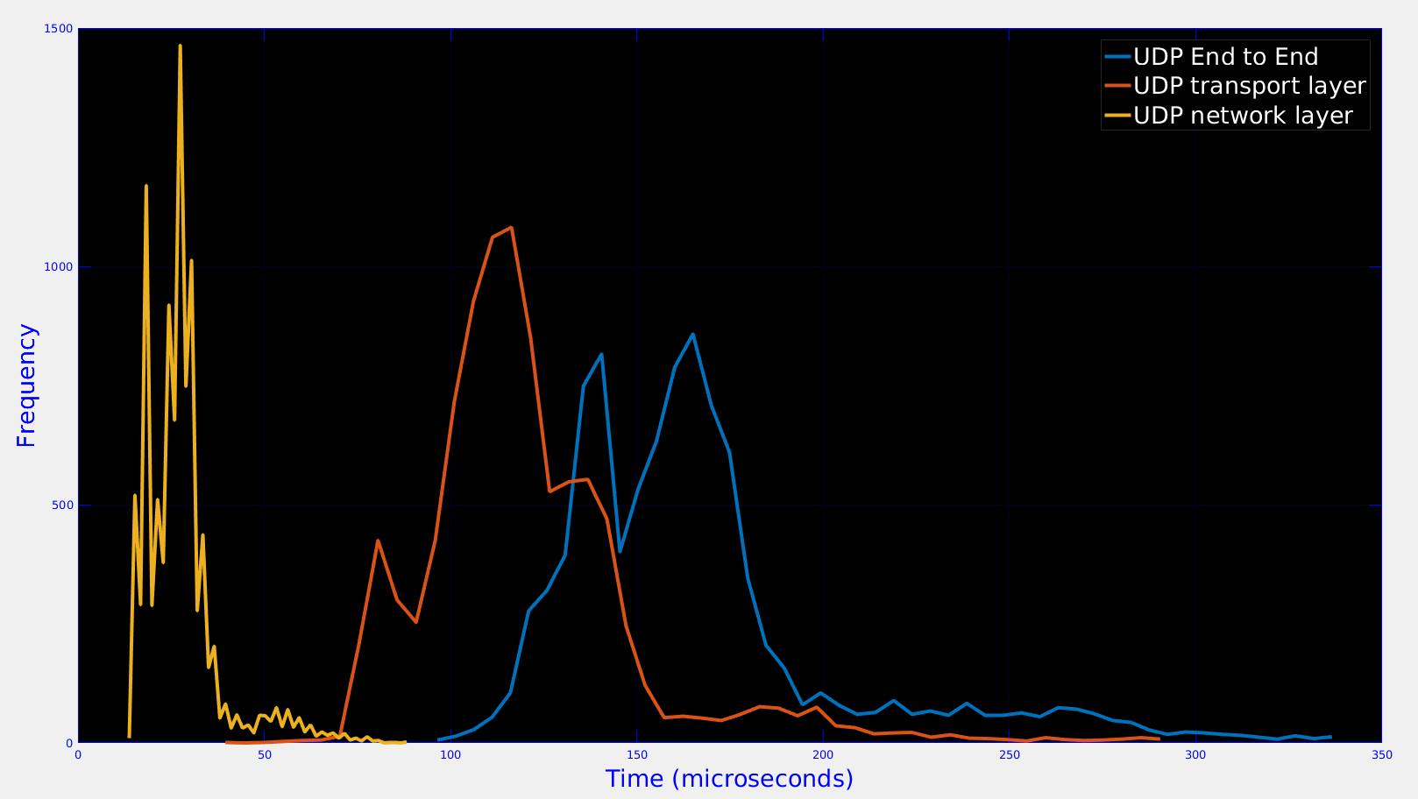
Results - UDP Packets

Slide 21
Experiment – TCP/IP Packets End to End
Entry point of kernel identified at the interface between the physical layer and Network Layer when the ethernet card (for wired connection) interrupts the OS.
Exit point is tcp_recvmsg() function in the transport layer.
SystemTap script written to probe two points and timestamp them. The difference in timestamps is the processing time.
Aforementioned script was run in parallel with the netcat tool (generates TCP traffic) in conjunction with a batch script to repeat the experiment multiple times.

Slide 22
Experiment – TCP/IP Packets Network Layer
Entry point of kernel identified at the interface between the physical layer and Network Layer when the ethernet card (for wired connection) interrupts the OS.
Exit point is tcp_v4_recv() function in the transport layer.
SystemTap script written to probe two points and timestamp them. The difference in timestamps is the processing time.
Aforementioned script was run in parallel with the netcat tool (generates TCP traffic) in conjunction with a batch script to repeat the experiment multiple times.
Note: Only IPv4 is being used

Slide 23
Analysis - TCP/IP Packets End to End
Analysis - TCP/IP Packets Network Layer
Statistics
Raw Average 314.129
Raw Median 241
Raw Mode 223
Standard Deviation 314.073
Average Without Outlier 258.345
Samples 10000
Connection Wired
Statistics
Raw Average 20.258
Raw Median 17
Raw Mode 16
Standard Deviation 8.11
Samples 10000
Connection Wired

Slide 24
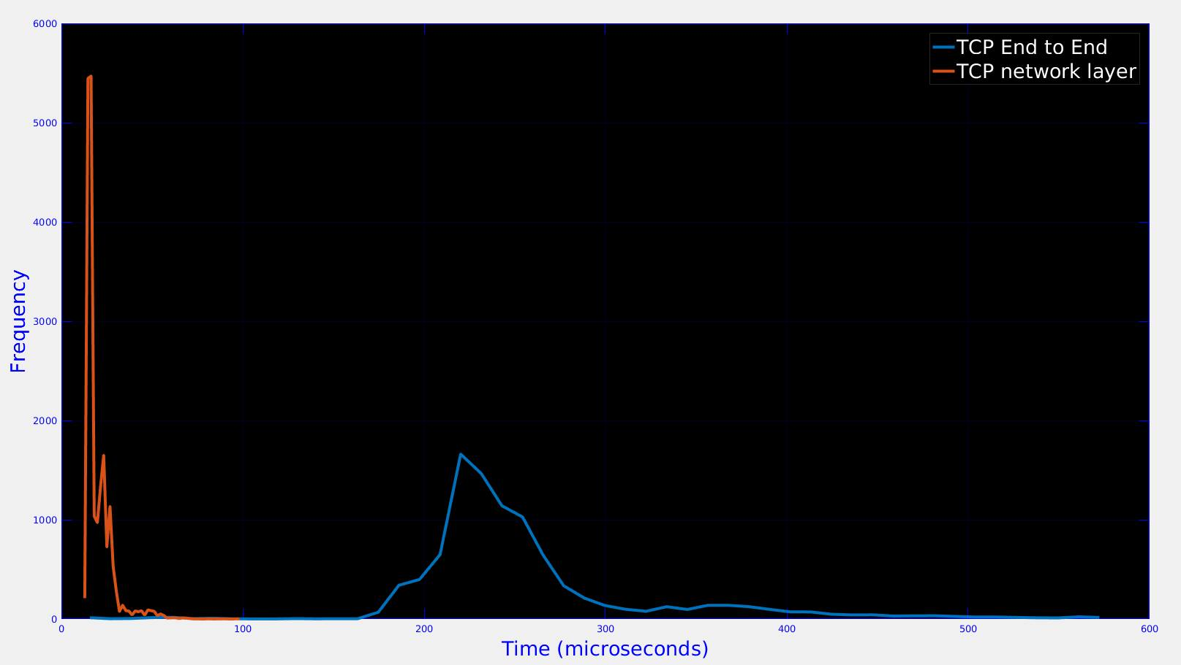
Results - TCP Packets

Slide 25
Design Process
Simplest case first considered
End to end measurement
Wired Connection
Same IP generating traffic
Packets of only one type generated
Following experiments will increase in complexity by adding more parameters or combining them in order to account for more realistic scenarios.
As many real life scenarios as possible will be covered to obtain an extensive set of data to analyze.

Slide 26
Future Plans
Divide the timings into smaller fragments to time by layer, function etc. to get a more clear overview of where the packet is spending most of its time.
Change connections to different types such as wireless and local to conduct experiments.
Change environment of experiments to include cloud machines and virtualized machines.
Use real time traffic instead of simulating through netcat.
Analyze possible sources of latency within the kernel code that could be avoided.
If time permits, design ways to reduce/avoid latency.

Slide 27
Proposed Timeline
Tasks | Start Time | End Time | Time Required
Measure Time spent within locations in the kernel | 02/09/2016 | 15/09/2016 | 2 weeks
Repeat Experiments with different connection types | 16/09/2016 | 30/09/2016 | 2 weeks
Use a cloud, virtualized and local test environment | 01/10/2016 | 31/10/2016 | 4 weeks
Data Analysis | 01/11/2016 | 18/11/2016 | 3 weeks
Documentation | 15/11/2016 | 08/11/2016 | 3 weeks

Slide 28
Thank you! Questions?

